Slide 1
Record – E

Slide 2
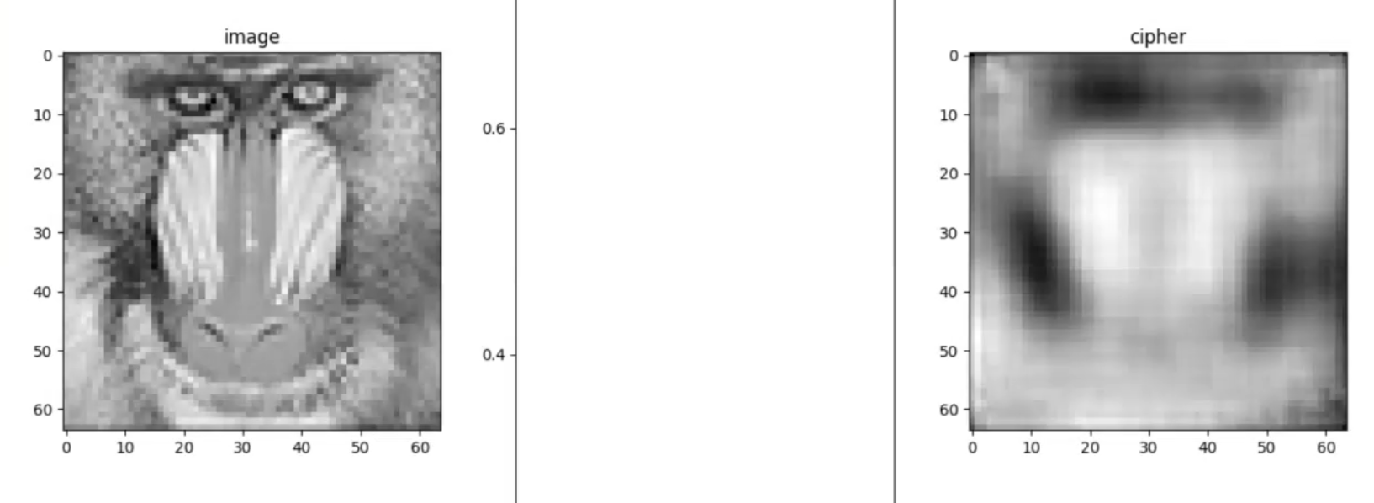
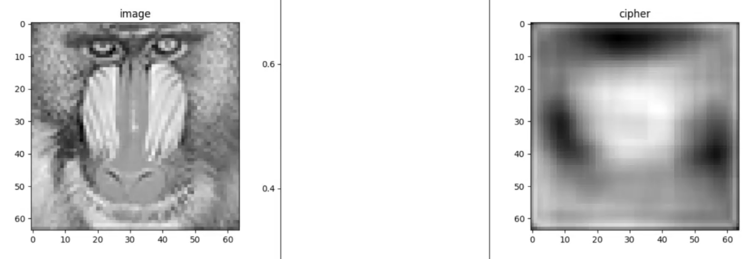
测试输出为输入的网络
增加层数至最大4096: 从200多到90多
用CNN/Linear都会模糊
lr = 0.00001. Adam: 250 (没收完) ↓;
SGD: 匀速收敛到280 ↓

Slide 3
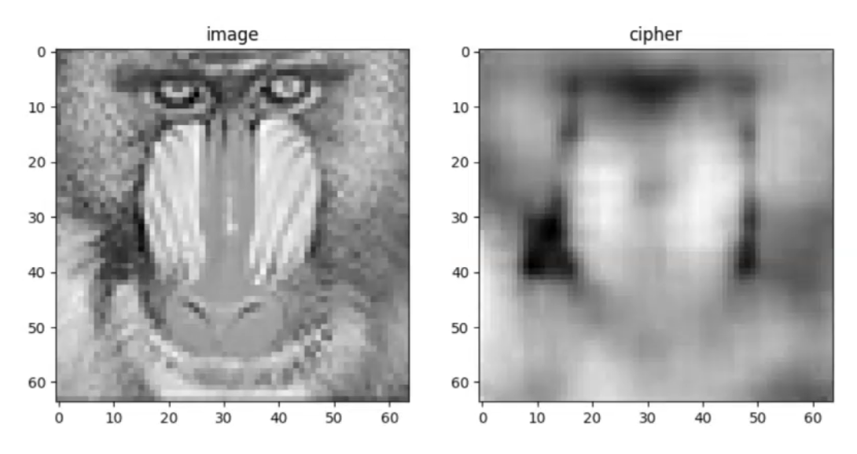
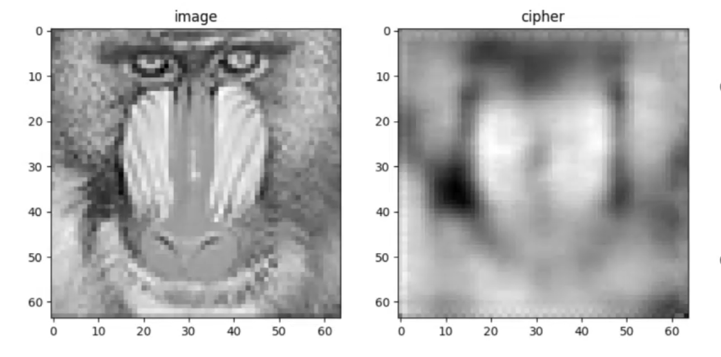
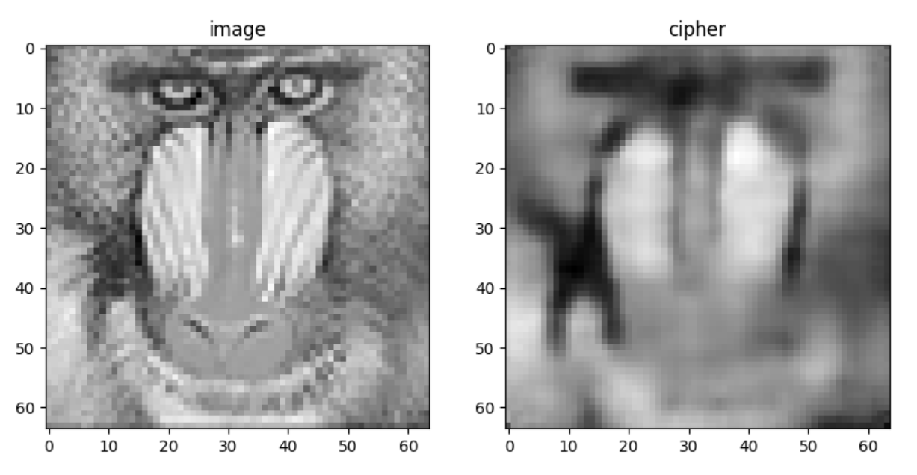
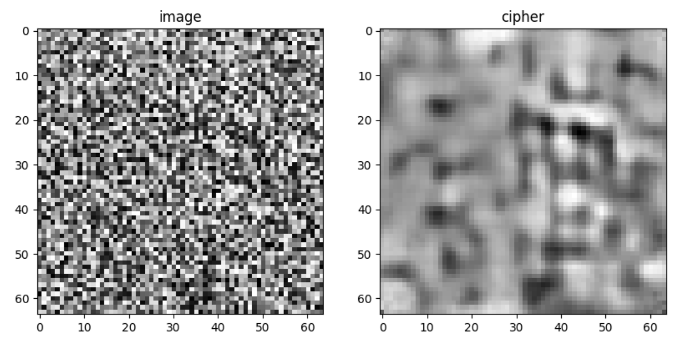
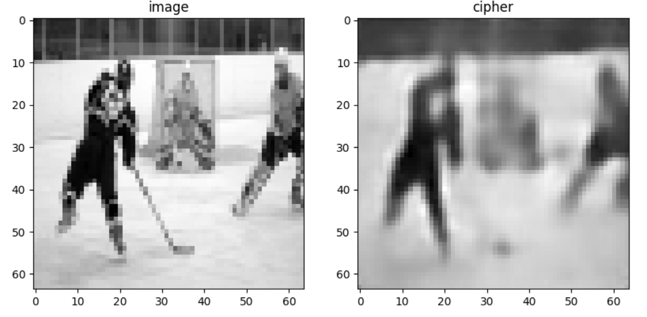
弃用pooling, stride = 2. Adam, lr = 0.001, epoch 20: 收敛到158↓
lr = 0.01: 收敛到168↓
SGD, lr=0.0001: 不收敛; lr = 0.001: 发散; lr=0.00001: 不收敛
Adam, lr = 0.001, epoch 20: 收敛到95 保存为E1↓
用训练集和随机图测试:

Slide 4
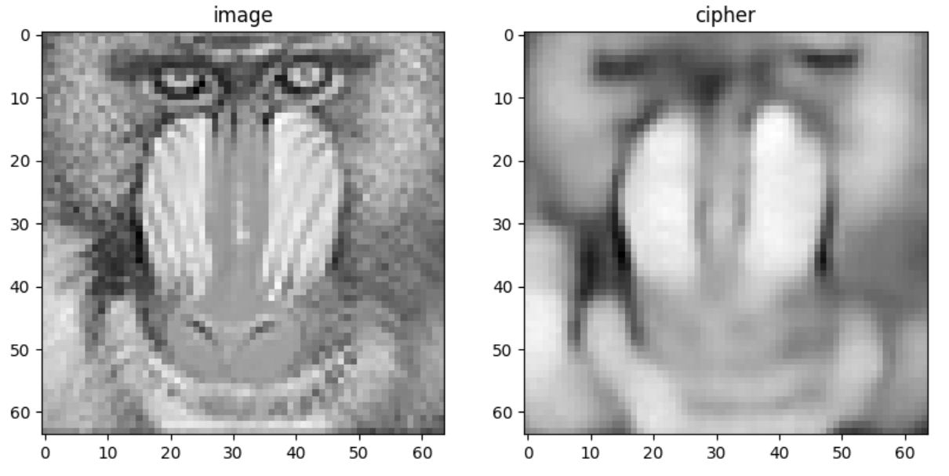
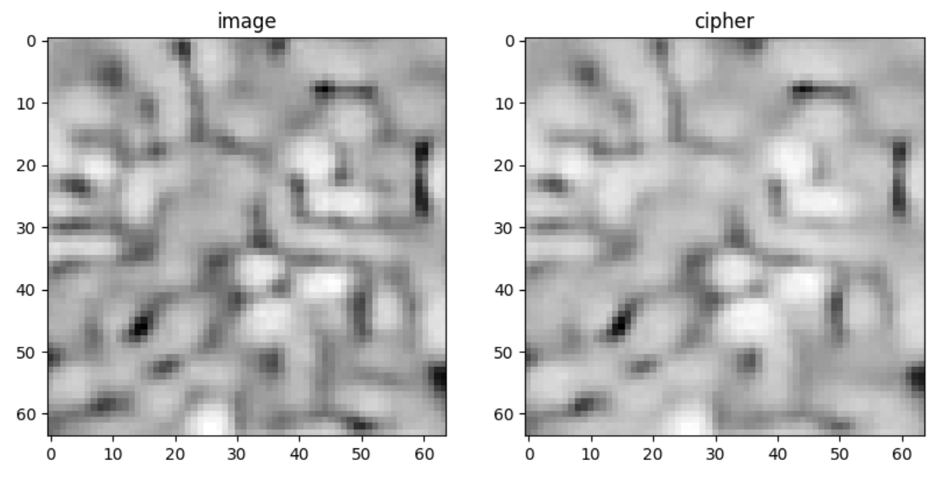
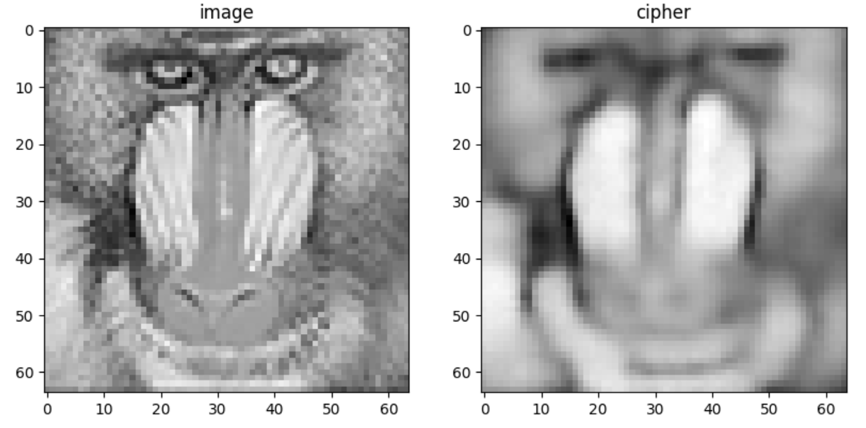
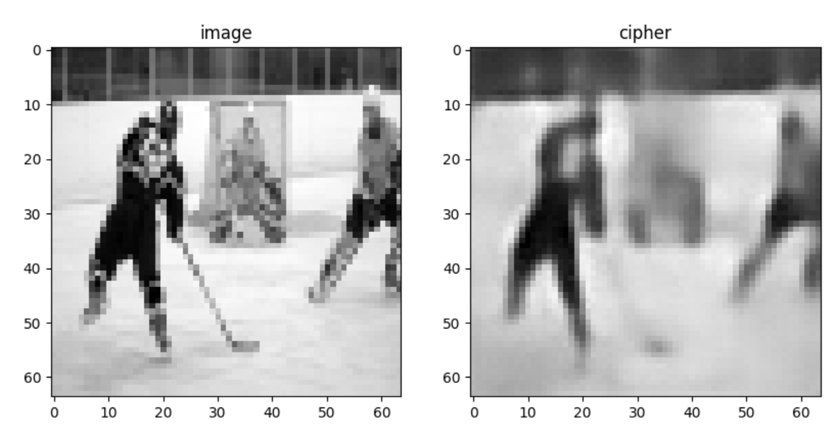
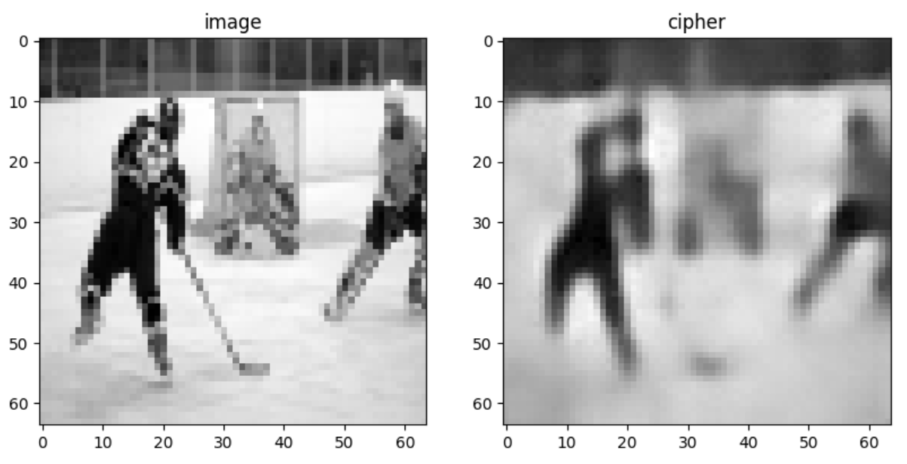
所有层都大于等于64. lr=0.001, epoch 20: 收敛到144
epoch 100: 收敛到68收不动了↓ 保存为E2; 步进一步: ↓
用E2继续练, epoch 100, lr = 0.00001: 基本无变化↓ 保存为E3
加bn. lr = 0.0001, epoch 20: loss100 ↓ 保存为E4 训练明显变慢
lr = 0.00001, epoch 80 用E4: loss90↓
Encoder加upsample decoder加pooling 最小层数从64变成16 加2层. Lr0.001 epoch20 收敛到150

Slide 5
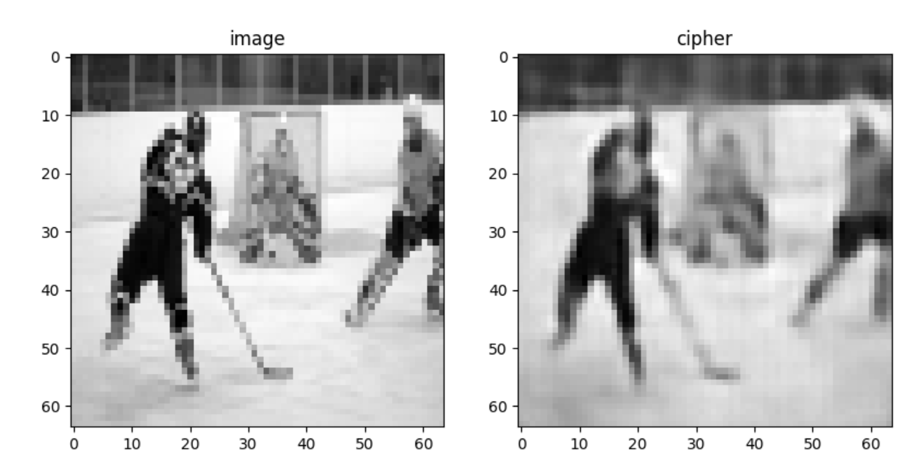
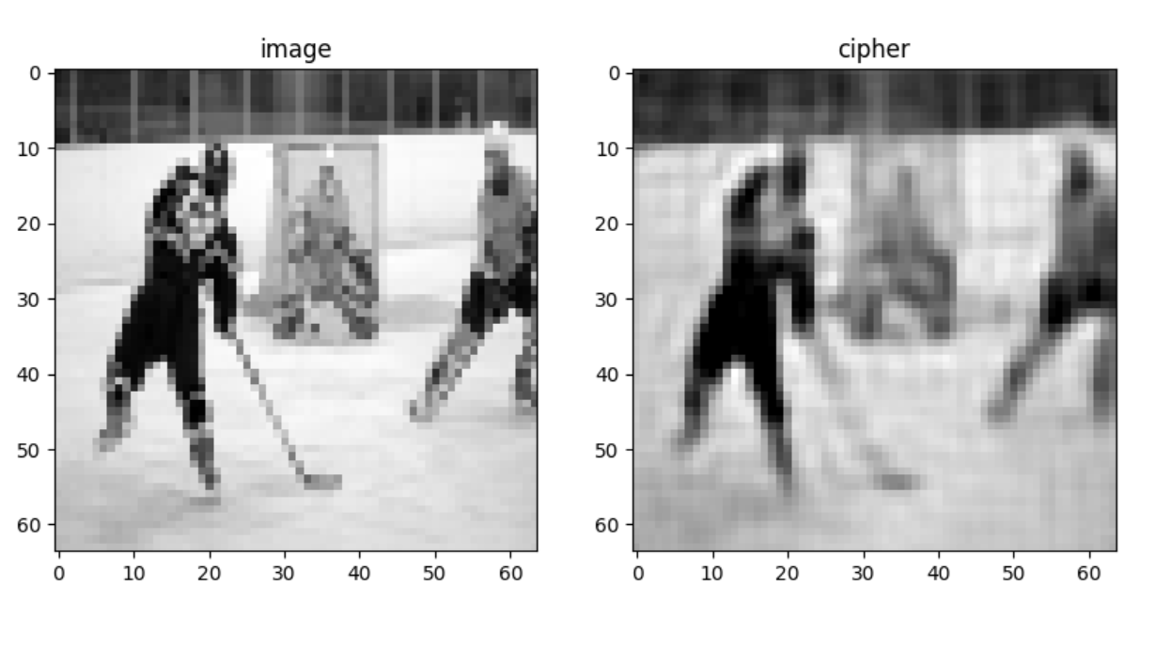
Epoch20, lr0.001 收敛到50
* 最低层数改为16 训练参数不变 存为E5
收敛到50
* 多反卷积一层：明显ringing 收敛还是50
self.encoder = nn.Sequential(# 64 64 1
nn.Upsample(scale_factor=2),
nn.Conv2d(1, 4, 6, 2, 1),# 64 64 4 input layer, output layer, kernel, stride, padding
nn.ReLU(True),
nn.BatchNorm2d(4),
nn.Conv2d(4, 16, 3, 2, 0),# 64 64 4 input layer, output layer, kernel, stride, padding
nn.ReLU(True),
nn.BatchNorm2d(16),
nn.Conv2d(16, 64, 3, 2, 0),# 64 64 4 input layer, output layer, kernel, stride, padding
nn.ReLU(True),
nn.BatchNorm2d(64),
nn.Conv2d(64, 256, 3, 2, 0),# 64 64 4 input layer, output layer, kernel, stride, padding
nn.ReLU(True),
nn.BatchNorm2d(256),
nn.Conv2d(256, 1024, 3, 2, 0),# 64 64 4 input layer, output layer, kernel, stride, padding
nn.ReLU(True),
nn.BatchNorm2d(1024),
nn.Conv2d(1024, 4096, 3, 2, 0),# 64 64 4 input layer, output layer, kernel, stride, padding
nn.ReLU(True),
nn.BatchNorm2d(4096),
# nn.Conv2d(4096, 16384, 3, 2, 0),# 64 64 4 input layer, output layer, kernel, stride, padding
# nn.ReLU(True),
)
self.decoder = nn.Sequential(
# nn.ConvTranspose2d(16384, 4096, 3, 2, 0), # 2 2 1024
# nn.ReLU(True),
nn.ConvTranspose2d(4096, 1024, 3, 2, 0), # 2 2 1024
nn.ReLU(True),
nn.BatchNorm2d(1024),
nn.ConvTranspose2d(1024, 256, 3, 2, 0), # 2 2 1024
nn.ReLU(True),
nn.BatchNorm2d(256),
nn.ConvTranspose2d(256, 64, 3, 2, 0), # 2 2 1024
nn.ReLU(True),
nn.BatchNorm2d(64),
nn.ConvTranspose2d(64, 16, 3, 2, 0), # 2 2 1024
nn.ReLU(True),
nn.BatchNorm2d(16),
nn.ConvTranspose2d(16, 4, 3, 2, 0), # 2 2 1024
nn.ReLU(True),
nn.BatchNorm2d(4),
nn.ConvTranspose2d(4, 1, 6, 2, 1), # 2 2 1024
nn.ReLU(True),
nn.BatchNorm2d(1),
nn.MaxPool2d(2),
# nn.Tanh()
)

Slide 6
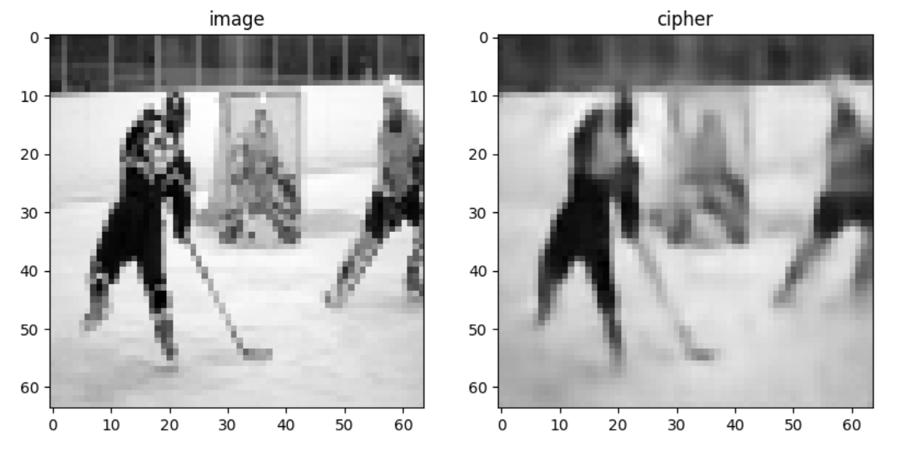
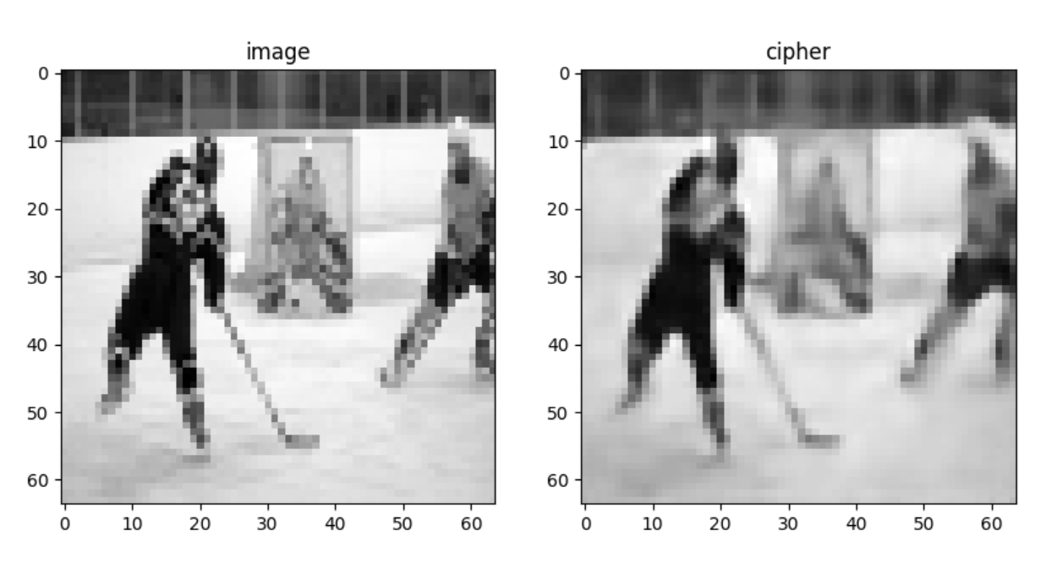
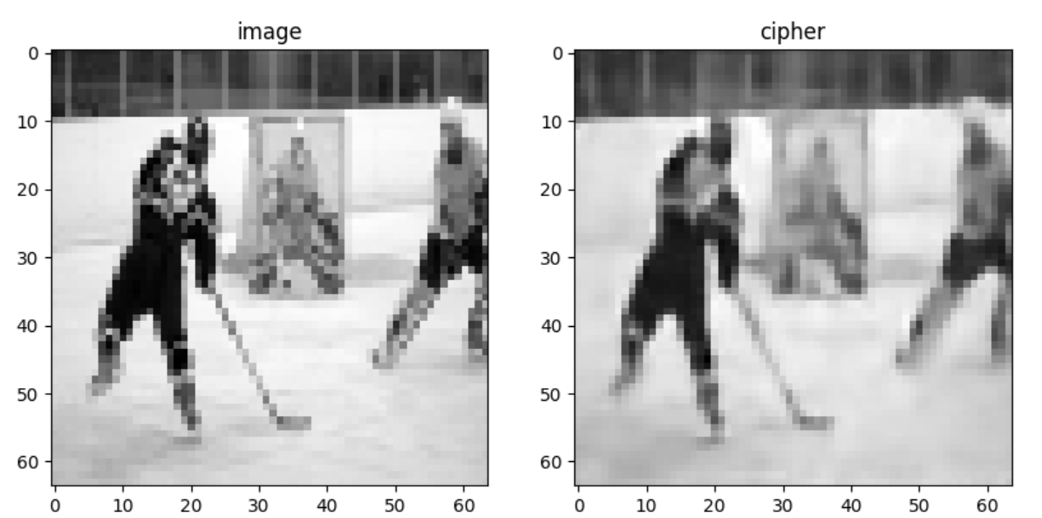
去掉多反卷积的一层和末尾的bn和relu 存为E6
继续训练80个epoch lr0.0002 收敛到40 用E6 存为E7
继续训练100个epoch lr0.0001 收敛到30 用E7 存为E8
class autoencoder(nn.Module):
def __init__(self):
super(autoencoder, self).__init__()
# self.encoder = nn.Sequential(# 64 64 1
# nn.Conv2d(1, 64, 3, 1, 1),
# nn.BatchNorm2d(64),
# nn.ReLU(True),
# nn.Conv2d(64, 64, 4, 2, 1),# 64 64 4 input layer, output layer, kernel, stride, padding
# nn.BatchNorm2d(64),
# nn.ReLU(True),
# # nn.MaxPool2d(2),# 32 32 4
# nn.Conv2d(64, 64, 4, 2, 1),# 32 32 16
# nn.BatchNorm2d(64),
# nn.ReLU(True),
# # nn.MaxPool2d(2),# 16 16 16
# nn.Conv2d(64, 64, 4, 2, 1),# 16 16 64
# nn.BatchNorm2d(64),
# nn.ReLU(True),
# # nn.MaxPool2d(2),# 8 8 64
# nn.Conv2d(64, 256, 4, 2, 1),# 8 8 256
# nn.BatchNorm2d(256),
# nn.ReLU(True),
# # nn.MaxPool2d(2),# 4 4 256
# nn.Conv2d(256, 1024, 4, 2, 1),# 4 4 1024
# nn.BatchNorm2d(1024),
# nn.ReLU(True),
# # nn.MaxPool2d(2),# 2 2 1024
# nn.Conv2d(1024, 4096, 2, 1, 0),# 1 1 4096
# nn.BatchNorm2d(4096),
# nn.ReLU(True),
# )
# self.decoder = nn.Sequential(
# nn.ConvTranspose2d(4096, 1024, 2, 1, 0), # 2 2 1024
# nn.BatchNorm2d(1024),
# nn.ReLU(True),
# # nn.Upsample(scale_factor=2),# 4 4 1024
# nn.ConvTranspose2d(1024, 256, 4, 2, 1),# 2 2 4096
# nn.BatchNorm2d(256),
# nn.ReLU(True),
# # nn.Upsample(scale_factor=2),# 4 4 1024
# nn.ConvTranspose2d(256, 64, 4, 2, 1),# 2 2 4096
# nn.BatchNorm2d(64),
# nn.ReLU(True),
# # nn.Upsample(scale_factor=2),# 4 4 1024
# nn.ConvTranspose2d(64, 64, 4, 2, 1),# 2 2 4096
# nn.BatchNorm2d(64),
# nn.ReLU(True),
# # nn.Upsample(scale_factor=2),# 4 4 1024
# nn.ConvTranspose2d(64, 64, 4, 2, 1),# 2 2 4096
# nn.BatchNorm2d(64),
# nn.ReLU(True),
# # nn.Upsample(scale_factor=2),# 4 4 1024
# nn.ConvTranspose2d(64, 64, 4, 2, 1),# 2 2 4096
# nn.BatchNorm2d(64),
# nn.ReLU(True),
# nn.ConvTranspose2d(64, 1, 3, 1, 1),# 2 2 4096
# # nn.Tanh()
# )
# self.encoder = nn.Sequential(# 64 64 1
# nn.Upsample(scale_factor=2),
# nn.Conv2d(1, 4, 3, padding=1, padding_mode='zeros'),# 64 64 4
# nn.ReLU(True),
# nn.MaxPool2d(2),# 32 32 4
# nn.Conv2d(4, 16, 3, padding=1, padding_mode='zeros'),# 32 32 16
# nn.ReLU(True),
# nn.MaxPool2d(2),# 16 16 16
# nn.Conv2d(16, 64, 3, padding=1, padding_mode='zeros'),# 16 16 64
# nn.ReLU(True),
# nn.MaxPool2d(2),# 8 8 64
# nn.Conv2d(64, 256, 3, padding=1, padding_mode='zeros'),# 8 8 256
# nn.ReLU(True),
# nn.MaxPool2d(2),# 4 4 256
# nn.Conv2d(256, 1024, 3, padding=1, padding_mode='zeros'),# 4 4 1024
# nn.ReLU(True),
# nn.MaxPool2d(2),# 2 2 1024
# nn.Conv2d(1024, 4096, 2),# 1 1 4096
# nn.ReLU(True),
# )
# self.decoder = nn.Sequential(
# nn.ConvTranspose2d(4096, 1024, 2), # 2 2 1024
# nn.ReLU(True),
# nn.Upsample(scale_factor=2),# 4 4 1024
# nn.ConvTranspose2d(1024, 256, 3, padding=1, padding_mode='zeros'),# 2 2 4096
# nn.ReLU(True),
# nn.Upsample(scale_factor=2),# 4 4 1024
# nn.ConvTranspose2d(256, 64, 3, padding=1, padding_mode='zeros'),# 2 2 4096
# nn.ReLU(True),
# nn.Upsample(scale_factor=2),# 4 4 1024
# nn.ConvTranspose2d(64, 16, 3, padding=1, padding_mode='zeros'),# 2 2 4096
# nn.ReLU(True),
# nn.Upsample(scale_factor=2),# 4 4 1024
# nn.ConvTranspose2d(16, 4, 3, padding=1, padding_mode='zeros'),# 2 2 4096
# nn.ReLU(True),
# nn.Upsample(scale_factor=2),# 4 4 1024
# nn.ConvTranspose2d(4, 1, 3, padding=1, padding_mode='zeros'),# 2 2 4096
# nn.MaxPool2d(2),
# # nn.Tanh()
# )
# self.linear = nn.Linear(4096, 4096)
# #编码器
# self.encoder = nn.Sequential(
# nn.Linear(4096, 128),
# nn.ReLU(True),
# nn.Linear(128, 64),
# nn.ReLU(True),
# nn.Linear(64, 32),
# nn.ReLU(True),
# nn.Linear(32, 32) # 输出的 code 是 3 维，便于可视化
# )
# #解码器
# self.decoder = nn.Sequential(
# nn.Linear(32, 32),
# nn.ReLU(True),
# nn.Linear(32, 64),
# nn.ReLU(True),
# nn.Linear(64, 128),
# nn.ReLU(True),
# nn.Linear(128, 4096),
# nn.Tanh() #使输出范围在-1~1
# )
self.encoder = nn.Sequential(# 64 64 1
nn.Upsample(scale_factor=2),
nn.Conv2d(1, 16, 6, 2, 1),# 64 64 4 input layer, output layer, kernel, stride, padding
nn.ReLU(True),
nn.BatchNorm2d(16),
nn.Conv2d(16, 16, 3, 2, 0),# 64 64 4 input layer, output layer, kernel, stride, padding
nn.ReLU(True),
nn.BatchNorm2d(16),
nn.Conv2d(16, 64, 3, 2, 0),# 64 64 4 input layer, output layer, kernel, stride, padding
nn.ReLU(True),
nn.BatchNorm2d(64),
nn.Conv2d(64, 256, 3, 2, 0),# 64 64 4 input layer, output layer, kernel, stride, padding
nn.ReLU(True),
nn.BatchNorm2d(256),
nn.Conv2d(256, 1024, 3, 2, 0),# 64 64 4 input layer, output layer, kernel, stride, padding
nn.ReLU(True),
nn.BatchNorm2d(1024),
nn.Conv2d(1024, 4096, 3, 2, 0),# 64 64 4 input layer, output layer, kernel, stride, padding
nn.ReLU(True),
nn.BatchNorm2d(4096),
# nn.Conv2d(4096, 16384, 3, 2, 0),# 64 64 4 input layer, output layer, kernel, stride, padding
# nn.ReLU(True),
)
self.decoder = nn.Sequential(
# nn.ConvTranspose2d(16384, 4096, 3, 2, 0), # 2 2 1024
# nn.ReLU(True),
nn.ConvTranspose2d(4096, 1024, 3, 2, 0), # 2 2 1024
nn.ReLU(True),
nn.BatchNorm2d(1024),
nn.ConvTranspose2d(1024, 256, 3, 2, 0), # 2 2 1024
nn.ReLU(True),
nn.BatchNorm2d(256),
nn.ConvTranspose2d(256, 64, 3, 2, 0), # 2 2 1024
nn.ReLU(True),
nn.BatchNorm2d(64),
nn.ConvTranspose2d(64, 16, 3, 2, 0), # 2 2 1024
nn.ReLU(True),
nn.BatchNorm2d(16),
nn.ConvTranspose2d(16, 16, 3, 2, 0), # 2 2 1024
nn.ReLU(True),
nn.BatchNorm2d(16),
nn.ConvTranspose2d(16, 1, 6, 2, 1), # 2 2 1024
nn.MaxPool2d(2),
# nn.Tanh()
)
def forward(self, x):
# x = x.reshape(x.shape[0], -1)
# x = self.linear(x)
# x = x.reshape(x.shape[0], 1, 64, 64)
encode = self.encoder(x)
# print(encode.shape)
decode = self.decoder(encode)
# decode = decode.reshape(x.shape[0], -1)
# decode = self.linear(x)
# decode = decode.reshape(decode.shape[0], 1, 64, 64)
# print(decode.shape)
return encode, decode
class autoencoder(nn.Module):
def __init__(self):
super(autoencoder, self).__init__()
self.encoder = nn.Sequential(# 64 64 1
nn.Upsample(scale_factor=2),
nn.Conv2d(1, 16, 6, 2, 1),# 64 64 4 input layer, output layer, kernel, stride, padding
nn.ReLU(True),
nn.BatchNorm2d(16),
nn.Conv2d(16, 16, 3, 2, 0),# 64 64 4 input layer, output layer, kernel, stride, padding
nn.ReLU(True),
nn.BatchNorm2d(16),
nn.Conv2d(16, 64, 3, 2, 0),# 64 64 4 input layer, output layer, kernel, stride, padding
nn.ReLU(True),
nn.BatchNorm2d(64),
nn.Conv2d(64, 256, 3, 2, 0),# 64 64 4 input layer, output layer, kernel, stride, padding
nn.ReLU(True),
nn.BatchNorm2d(256),
nn.Conv2d(256, 1024, 3, 2, 0),# 64 64 4 input layer, output layer, kernel, stride, padding
nn.ReLU(True),
nn.BatchNorm2d(1024),
nn.Conv2d(1024, 4096, 3, 2, 0),# 64 64 4 input layer, output layer, kernel, stride, padding
nn.ReLU(True),
nn.BatchNorm2d(4096),
# nn.Conv2d(4096, 16384, 3, 2, 0),# 64 64 4 input layer, output layer, kernel, stride, padding
# nn.ReLU(True),
)
self.decoder = nn.Sequential(
# nn.ConvTranspose2d(16384, 4096, 3, 2, 0), # 2 2 1024
# nn.ReLU(True),
nn.ConvTranspose2d(4096, 1024, 3, 2, 0), # 2 2 1024
nn.ReLU(True),
nn.BatchNorm2d(1024),
nn.ConvTranspose2d(1024, 256, 3, 2, 0), # 2 2 1024
nn.ReLU(True),
nn.BatchNorm2d(256),
nn.ConvTranspose2d(256, 64, 3, 2, 0), # 2 2 1024
nn.ReLU(True),
nn.BatchNorm2d(64),
nn.ConvTranspose2d(64, 16, 3, 2, 0), # 2 2 1024
nn.ReLU(True),
nn.BatchNorm2d(16),
nn.ConvTranspose2d(16, 16, 3, 2, 0), # 2 2 1024
nn.ReLU(True),
nn.BatchNorm2d(16),
nn.ConvTranspose2d(16, 1, 6, 2, 1), # 2 2 1024
nn.MaxPool2d(2),
# nn.Tanh()
)

Slide 7
改变最后一层
最后加一层 只训练其中一层

